Slide 1
Real Estate Program
Leasing Transaction Process
Office of the State Architect
Division of State Property

Slide 2
Mission
Provide services and assistance to state agencies and institutions of higher education to maximize value received for all funds expended on real estate and real estate related requirements.
Responsible to provide the procedural guidance expertise, business sense, and marketplace knowledge to negotiate favorable leases and other real estate contracts for state agencies/institutions.

Slide 3
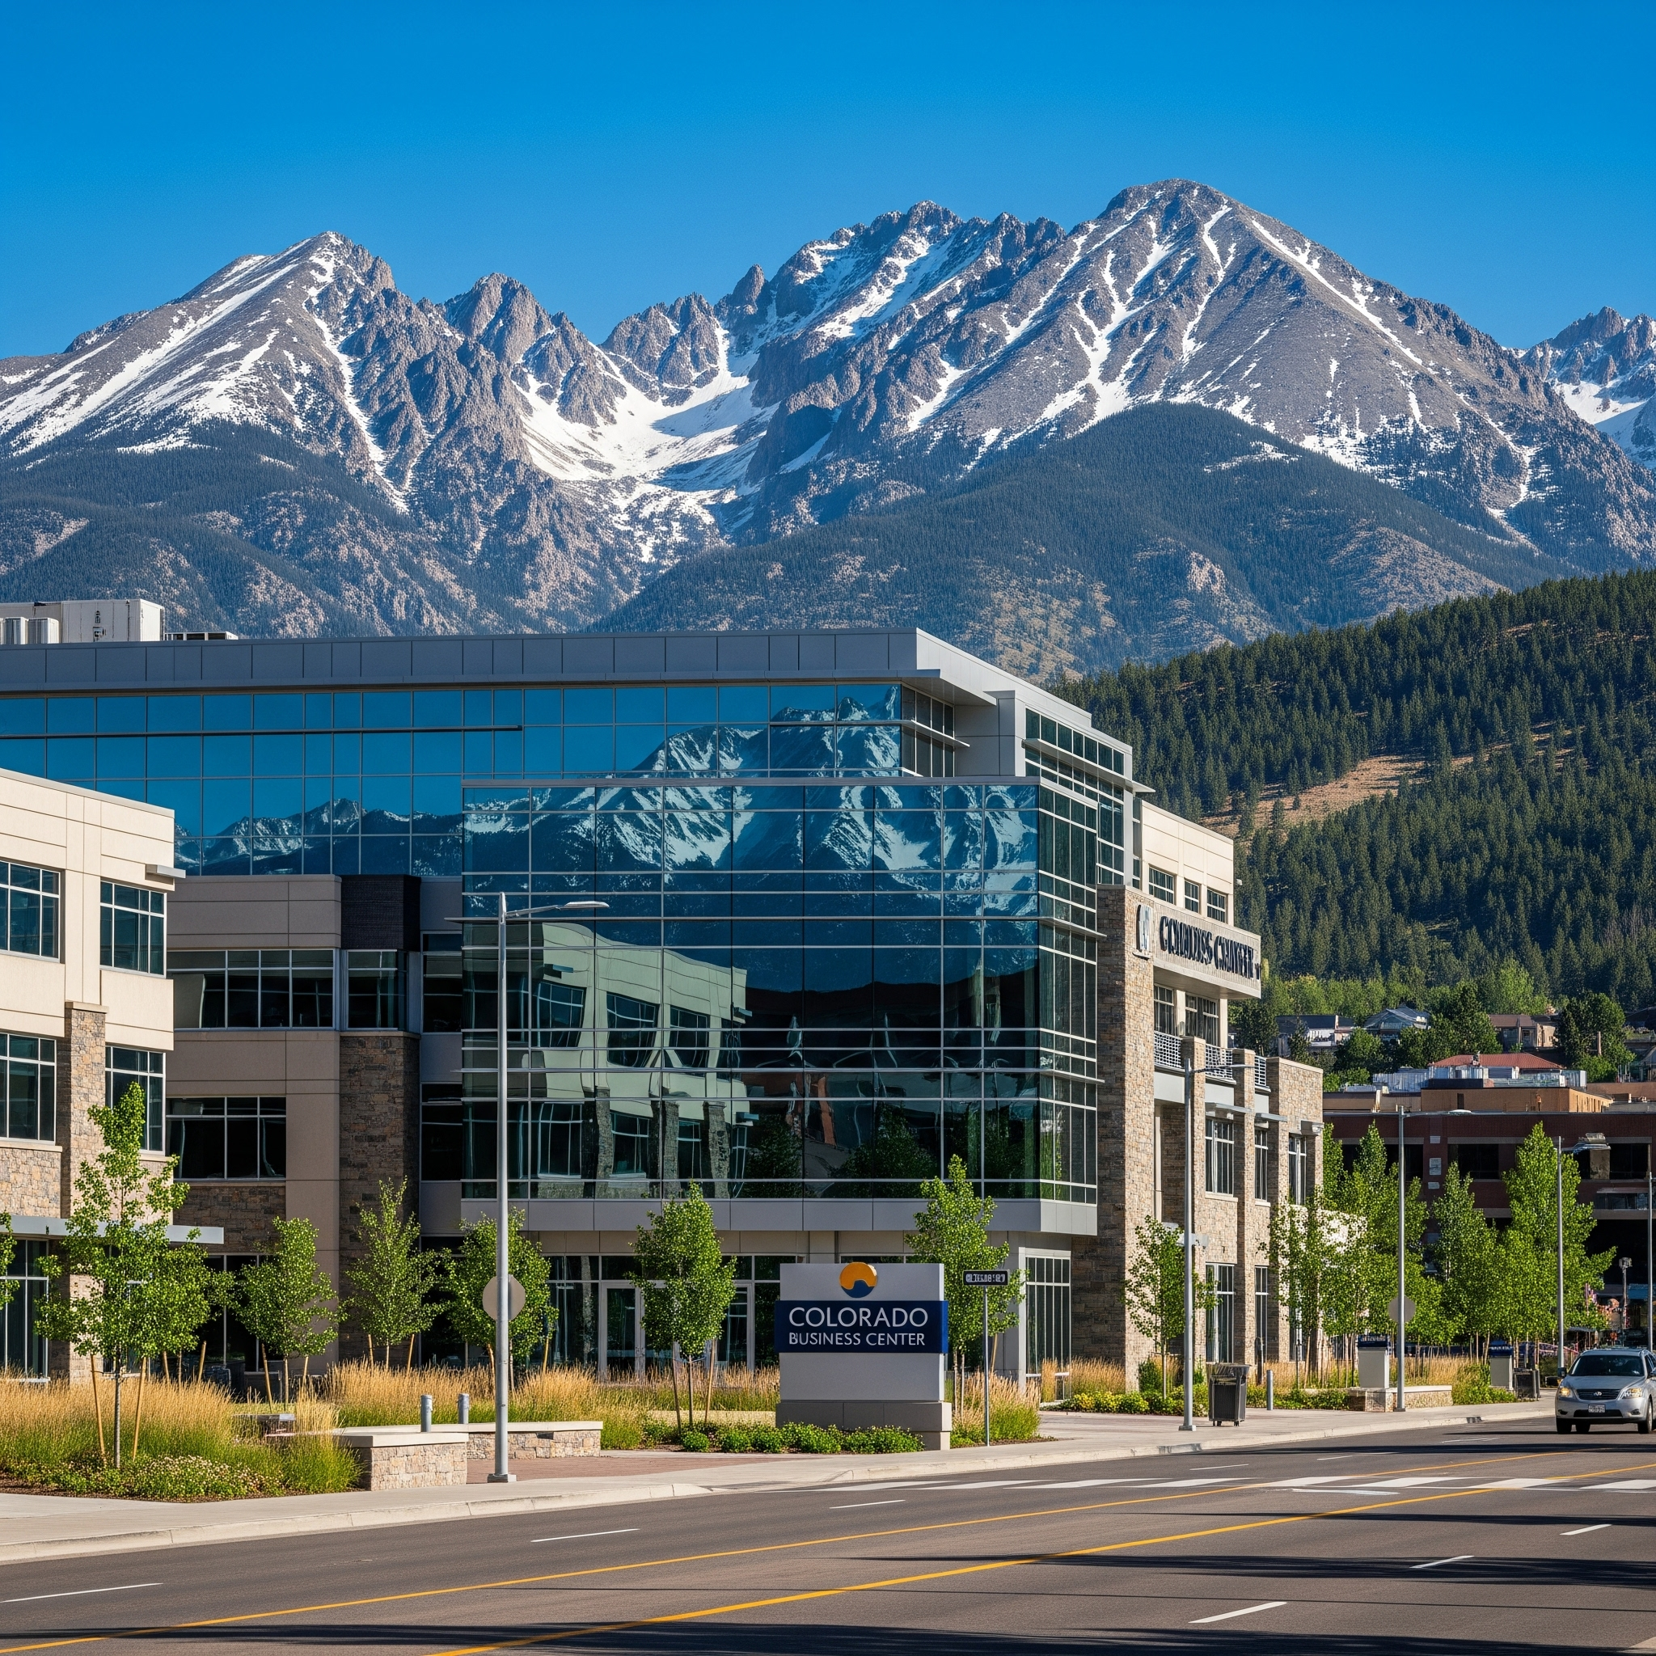


Leasing
Procedures

Slide 4
Basic Steps
1- Request and Approval Phase
2- Engagement Phase
3- Transaction Phase

Slide 5
1 - Request and Approval Phase
Submit Space Request Form to REP - New web form
Consult to review needs, confirm budget has been secured, review colocation options, and determine Broker involvement
Engage State Service Broker - Tenant Authorization Agreement
In locations not covered by state service broker, determine if outside broker to be used or if agency or institution handle internally with REP oversight

Slide 6
2- Engagement Phase
Consult with Broker
Review needs (square footage, location, type, etc.)
Discuss current market conditions
Tour possible locations
Analyze options

Slide 7
3 - Transaction Phase
Solicit offers from preferred locations (RFP)
Review financial analysis; Select location
Broker prepares lease draft, Submit to landlord
Negotiations, sometimes multiple rounds
Final approvals and signatures

Slide 8
Tax Exempt Leases
As of 2009, the State is exempt from the levy and collection of property tax on all State leased properties during the term of the use and possession of the property.
Minimum one year term.
Applies to land leases as well as building leases.
Department is responsible for filing lease copies with the county.

Slide 9
Document Drafting
If Broker is involved, Broker will draft documents.
Lease templates include:
Gross Lease
Lease Amendment
Interagency Lease
Interagency Amendment
Sublease
State Owned Lease
Easement - Grantor
Easement - Grantee
License Agreement
Parking Agreement

Slide 10
Document Review
The fewer variations from the State's lease template, the faster the lease will move through the approval process
All of the wording in the standard templates has been pre-approved by the Attorney General's office and the State Controller’s Office
If changes are necessary, submit before finalizing negotiations for REP for a preliminary opinion on the likelihood of approval of the changes

Slide 11
Signature Authority
1) Tenant
2) Landlord
3) Real Estate Programs
4) Legal (if necessary)
5) Risk (if necessary)
6) Controller (final approval)
No lease is valid, no rents authorized, until the State Controller approves and signs

Slide 12
State Service Broker
In the seven county metro area, executive branch State agencies must use the State real estate service broker for any real estate transaction activity (new lease, amending current lease, buying or selling)
In rare exceptions, Agencies may apply for a waiver to utilize the services of a non-State contracted real estate broker.
Reviewed on a case-by-case basis
Require written approval by the Real Estate Program manager prior to any engagement of a broker.

Slide 13
Specific Counties
Denver Metro Area -
Adams, Arapahoe, Broomfield, Boulder, Denver, Douglas and Jefferson
Covered by JLL
El Paso and Pueblo Counties -
Covered by SOCO Commercial Group

Slide 14
Professional Real Estate Representation
Provides significant advantages to the State
Save time and money
Conduct needs assessments and space programming
Knowledge of the complicated state processes
Effectively advocate for state departments
Assures State dollars are spent wisely

Slide 15


Broker Services
Space planning and construction pricing
Final determination of site
Landlord negotiations
Execution of lease
Lease administration
Needs assessment
Market survey
Physical inspection of properties
Solicitation of Offers
Facilitate negotiations
Cost analysis

Slide 16
Broker Compensation
No particular rate of commission mentioned in the contract
No assurance by the State that any commission at all will be paid on any particular transaction
Broker compensation is negotiable
State Service Brokers will always attempt to receive compensation from the counterparty
Broker's also provide Consulting Services at hourly rates

Slide 17
Early Termination of a Lease
Any decision related to early termination of a lease should be discussed with the Real Estate Program manager before taking any action.
Typically included occurrences:
• Fiscal Funding
• Federal Funding
• Collocation
Use of one of these early termination clauses may open the state up to potential liability

Slide 18
Reporting Requirements
Colorado statutes require that all acquisitions and dispositions of real estate by all agencies and institutions of higher education must be reported to the Real Estate Program.
Exceptions for State Land Board, Parks & Wildlife, and CDOT
Used to fulfill multiple statutory responsibilities for maintaining current inventories

Slide 19
Real Estate Program Staff
Cameron Kennedy- Real Estate Program Manager
cameron.kennedy@state.co.us
720-402-4146
Jennifer Threlkeld- Real Estate Specialist
jennifer.threlkeld@state.co.us
720-813-7642

