Slide 1
Real Estate Program
Policy & Procedure Manual
Office of the State Architect
Division of State Property

Slide 2
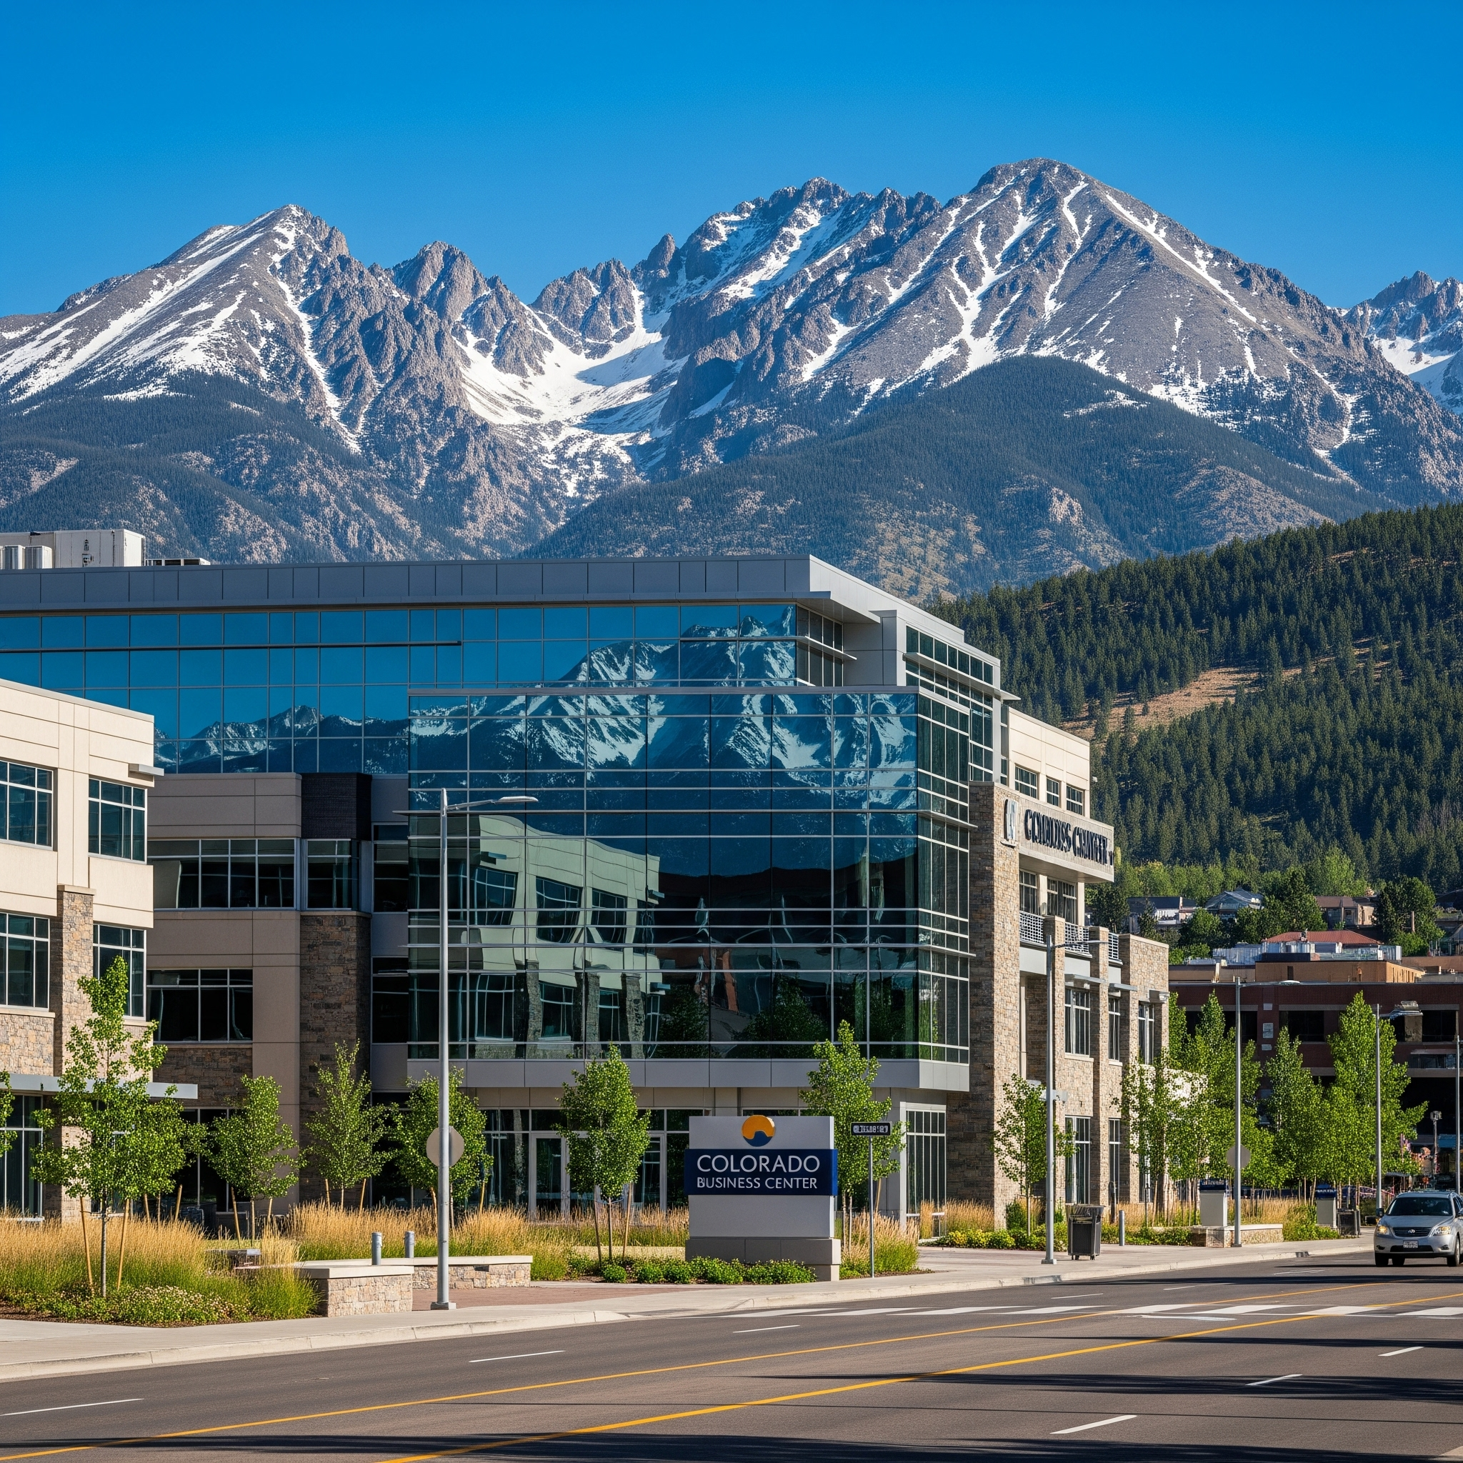


Chapter 1 - Introduction

Slide 3
Introduction
Colorado statutes require that all real estate activity (including leasing, interagency, acquisition, and disposition) for all agencies and institutions of higher education, except the State Land Board and CDOT rights-of-way, must be reported to the Real Estate Program.
Used to fulfill its statutory responsibility to maintain a current inventory of all State-owned and State-leased real estate.

Slide 4
Mission
Provide services and assistance to state agencies and institutions of higher education to maximize value received for all funds expended on real estate and real estate related requirements.
Responsible to provide the procedural guidance expertise, business sense, and marketplace knowledge to negotiate favorable leases and other real estate contracts for state agencies/institutions.
Also a central resource for information on the State's real estate holdings

Slide 5
Exceptions
Rights-of-way acquisition and maintenance by the Department of Transportation
Long term holding of State land by the State Land Board
Certain easements, rights-of way, vacant land leases and acquisitions by the Division of Wildlife or the Parks and Recreation Division of the Department of Natural Resources

Slide 6
Chapter 2 - Centralized
Leasing
Policy

Slide 7
C.R.S. § 24-30-1303(1)
a. Negotiate and execute leases with private lessors and state owned lands
b. Negotiate and approve easements and rights-of-way
h. Develop office space occupancy standards
Applies to all space acquisitions whether by lease, sublease, lease/ purchase or license

Slide 8
Statutory Authority
C.R.S. § 24-30-1303.5
(1) Maintain an inventory of all state-owned lands and buildings. Maintain an inventory of all leases. Correct any defects in order to vest marketable title in the state.
(3) Establish procedure for required reporting of all acquisitions and dispositions of real property.
(6) Prepare and provide an annual report of acquisitions and dispositions to the CDC

Slide 9
Real Estate Transactions
Ensure they serve the needs of the State
Are completed according to specific requirements set out in the state’s constitution, statutes, fiscal rules, and official policies and procedures
Most importantly, must represent a fair value to the State in the prevailing market conditions

Slide 10
Responsibilities include:
1. Review and approval of real estate contracts
2. Coordinate real estate activities with real estate support services vendor
3. Maintain an inventory of state-owned and leased properties
4. Develop a centralized leasing policy and office space standards for leased space
5. Annually report acquisitions, dispositions and lease summaries to the Colorado General Assembly’s Capital Development Committee

Slide 11
Real Estate Delegate Authority
Limited delegation of authority is made available pursuant to the authority granted in 24-30-1303 (5) (a) C.R.S.
Responsible for being the primary point of contact for real estate matters
Different from the State Buildings Delegate
Must be obtained in writing from DPA and OSA

Slide 12
Chapter 3 - Leasing
Procedures

Slide 13
Basic Steps
1- Request and Approval Phase
2- Engagement Phase
3- Transaction Phase

Slide 14
1 - Request and Approval Phase
Submit Space Request Form to REP - New web form
Consult to review needs, confirm budget has been secured, review colocation options, and determine Broker involvement
Engage State Service Broker - Tenant Authorization Agreement
In locations not covered by state service broker, determine if outside broker to be used or if agency or institution handle internally with REP oversight

Slide 15
2- Engagement Phase
Consult with Broker
Review needs (square footage, location, type, etc.)
Discuss current market conditions
Tour possible locations
Analyze options

Slide 16
3 - Transaction Phase
Solicit offers from preferred locations (RFP)
Review financial analysis; Select location
Broker prepares lease draft, Submit to landlord
Negotiations, sometimes multiple rounds
Final approvals and signatures

Slide 17
Green Lease Policy
Executive Order D 2022 016, signed April 22, 2022
Setting and achieving environmental performance objectives
New, existing, and renewing lease agreements
Energy, water, and greenhouse gas emissions
The lease is for 75% or more of the building's rentable square feet;
The leased space's utilities are sub-metered; and
The rentable square feet of the leased area is 10,000 square feet or more.

Slide 18
Colocation Requirements
In accordance with the overall policy and directives of Colorado State Government, agencies should attempt to collocate their operations wherever possible, and therefore their leased premises, so as to reduce the number of locations.
Additionally, the policies of Real Estate Programs will be applied to support the Colorado State Government's plans, whenever possible in the future, to buy or build State Office Buildings, and thereby reduce the requirements for leasing various agencies' locations.

Slide 19
Document Review
The fewer variations from the State's lease template, the faster the lease will move through the approval process
All of the wording in the standard templates has been pre-approved by the Attorney General's office and the State Controller’s Office
If changes are necessary, submit before finalizing negotiations for REP for a preliminary opinion on the likelihood of approval of the changes

Slide 20
Signature Authority
1) Tenant
2) Landlord
3) Real Estate Programs
4) Legal (if necessary)
5) Risk (if necessary)
6) Controller (final approval)
No lease is valid, no rents authorized, until the State Controller approves and signs

Slide 21
Early Termination of a Lease
Any decision related to early termination of a lease should be discussed with the Real Estate Program manager before taking any action.
Typically included occurrences:
• Fiscal Funding
• Federal Funding
• Collocation
Use of one of these early termination clauses may open the state up to potential liability

Slide 22
Chapter 4 - Leasing Forms

Slide 23
Gross Lease Agreement
Language that addresses specific laws or other state requirements must be in every lease. Presently the following seven paragraphs contain language:
2. Tenant’s Tax Exempt Status
12. Eminent Domain, Damage and Destruction
14. Fiscal Funding
15. Federal Funding
20. Colocation
21. No Violation of Law
22. Colorado Special Provisions

Slide 24
Interagency Lease Agreement
Greatly simplified paragraph on fiscal funding contingency
Another paragraph provides for arbitration by the State Controller in the event of any dispute between the parties
Does not require an approval by (nor signature block for) the Attorney General.

Slide 25
Lease Amendment Template
Used for changes to existing leases, such as addition or reduction of space utilized, change of rental rate, as well as lease extensions or renewals of the lease term including renewal options
If several changes are required, appropriately used for all of the changes on one form at one time
Within covered counties, the State Broker should be utilized for negotiation and preparation of an Amendment to Lease
Lease amendments must be cleared through the entire approval process, just as it would be for a new lease

Slide 26
Accessibility for All
A paramount goal of the State as well as REP policy is that all properties under consideration meet and comply with all applicable sections of the Americans with Disabilities Act (“ADA”).
These requirements must be considered in every step during the completion of a lease agreement and possible build-out of space.
With the passage of § 24-85-101, C.R.S., the state affirms its commitment to improve access to information, including electronic information, for individuals with a disability.

Slide 27
Chapter 5 - State Service Broker

Slide 28
State Service Broker
In the seven county metro area, executive branch State agencies must use the State real estate service broker for any real estate transaction activity (new lease, amending current lease, buying or selling)
In rare exceptions, Agencies may apply for a waiver to utilize the services of a non-State contracted real estate broker.
Reviewed on a case-by-case basis
Require written approval by the Real Estate Program manager prior to any engagement of a broker.

Slide 29
Specific Counties
Denver Metro Area -
Adams, Arapahoe, Broomfield, Boulder, Denver, Douglas and Jefferson
Covered by JLL
El Paso and Pueblo Counties -
Covered by SOCO Commercial Group

Slide 30
Professional Real Estate Representation
Provides significant advantages to the State
Save time and money
Conduct needs assessments and space programming
Knowledge of the complicated state processes
Effectively advocate for state departments
Assures State dollars are spent wisely

Slide 31


Broker Services
Space planning and construction pricing
Final determination of site
Landlord negotiations
Execution of lease
Lease administration
Needs assessment
Market survey
Physical inspection of properties
Solicitation of Offers
Facilitate negotiations
Cost analysis

Slide 32
Broker Compensation
No particular rate of commission mentioned in the contract
No assurance by the State that any commission at all will be paid on any particular transaction
Broker compensation is negotiable
State Service Brokers will always attempt to receive compensation from the counterparty
Broker's also provide Consulting Services at hourly rates

Slide 33
Chapter 6 - Easements and Licensing Agreements

Slide 34
Easement Agreements / Licensing Agreements / Parking Agreements
Templates for Easement Agreements include language for when the State is the Grantor or the Grantee
License Agreements are for temporary, non-exclusive use of a space
Parking Agreements contain language for parking use agreements

Slide 35
Chapter 7 - Office Space Standards

Slide 36
Office Space Standards
Executive Order D 2020 175: Equity, Diversity and Inclusion
Directives to foster a healthier, more equitable and inclusive workplace for all of Colorado; A space where employees, community partners and the public alike feel valued and respected.
Agencies have an opportunity to address the operational needs for an inclusive working environment that supports and engages all employees.
Standards for Measuring Overall Space Use Efficiency

Slide 37
Space Standard Recommendations
The current recommendations include rightsizing assumptions for spaces, and assumptions for ratios of collaboration and support space to offices and workstations.
Rightsizing refers to the process of identifying and calculating what the actual space need is to meet requirements specific to end-user groups.
Actual individual space allocations will be determined on the basis of functional space requirements, the priorities of the organization, and the total space and budget available.

Slide 38
Chapter 8 - Higher Edication

Slide 39
Colorado Commission on Higher Education Leasing Policy
Any acquisition or utilization of real property by a state-supported institution of higher education, shall be subject to the approval of the Commission, whether acquisition is by lease, lease- purchase, purchase, gift or otherwise, § 23-1-106(8), C.R.S.
Institutions of Higher Education should check with CCHE to make sure they are using the most current forms and following the most current CCHE procedures.
‌Colorado Com

Slide 40
Chapter 9 - Acquisitions
and
Dispositions

Slide 41
Acquisitions = Purchases
Request assistance from ELT and REP with decision making early as possible
Notify OSPB of intent to acquire property
Evaluate alternative strategies- co-location, renovation, construction
Determine funding source and payment method
Engage state service broker
Verify necessary approvals- OSPB, CDHE, CDC, legislature, AG

Slide 42
Dispositions = Sales
Request assistance from ELT and REP with decision making early as possible
Notify OSPB or CCHE of intent
Verify necessary approvals- OSPB, CDHE, CDC, legislature, Attorney General
Prepare file documentation- survey, title commitment, environmental study, appraisal, property condition report, ADA assessment, historical preservation
Determine method of sale- sealed bid, broker listing

Slide 43
Title Transfers
Some departments have statutory authority to conduct acquisitions and dispositions of real property within their agency.
Disposition process can be lengthy, lasting multiple years and spanning multiple phases depending on the size and scope of the project. Can be more efficient to first transfer the property title to DPA, allowing for the Real Estate Program to oversee the fulfillment process of these complicated transactions.

Slide 44
Chapter 10 - Statutory Authority

Slide 45
Statutory Authority Overall
Colorado Revised Statutes (C.R.S.) allow each agency and educational institution to direct the planning and management of real estate use and construction.
Initial oversight by the Governor's Office of State Planning and/or Budget (OSPB) or by the Colorado Commission on Higher Education (CCHE)
The, presented to the Capital Development Committee (CDC) of the Colorado General Assembly (GA) and the recommendations of the CDC are made to the Joint Budget Committee (JBC).
In addition, separate permission must be obtained from the CDC when real property is acquired or disposed.

Slide 46
Statutory Authority – A & D
C.R.S. § 24-30-1301(2)
Capital construction includes:
“Acquisition of a capital asset or disposition, construction, demolition, remodeling or renovation, site improvement or development of real property…”
Requires the Real Estate Program to be actively involved in, and sign off on, the acquisition of real estate.

Slide 47
Also review
• Colorado Constitution
• Colorado Revised Statutes, as amended, C.R.S. § 24-30-1303
• Department of Law policies
• Fiscal Rules (issued by the State Controller)
• State of Colorado Contract Procedures and Management Manual
• Executive orders (issued by the Governor)

Slide 48
Real Estate Program Staff
Cameron Kennedy- Real Estate Program Manager
cameron.kennedy@state.co.us
720-402-4146
Jennifer Threlkeld- Real Estate Specialist
jennifer.threlkeld@state.co.us
720-813-7642

