Slide 1
Overview of the
Real Estate Program
Office of the State Architect
Division of State Property

Slide 2
Mission
Provide services and assistance to state agencies and institutions of higher education to maximize value received for all funds expended on real estate and real estate related requirements.
Responsible to provide the procedural guidance expertise, business sense, and marketplace knowledge to negotiate favorable leases and other real estate contracts for state agencies/institutions.

Slide 3
Not Just Leasing
Purchase of real estate for the State
Sale or lease of State-owned real estate
Negotiation and execution of license agreements, parking agreements, rights-of-way and easement agreements- either on non-state land for the use of the State, or on State land for the use of private parties

Slide 4
Exceptions
Rights-of-way acquisition and maintenance by the Department of Transportation
Long term holding of State land by the State Land Board
Certain easements, rights-of way, vacant land leases and acquisitions by the Division of Wildlife or the Parks and Recreation Division of the Department of Natural Resources

Slide 5
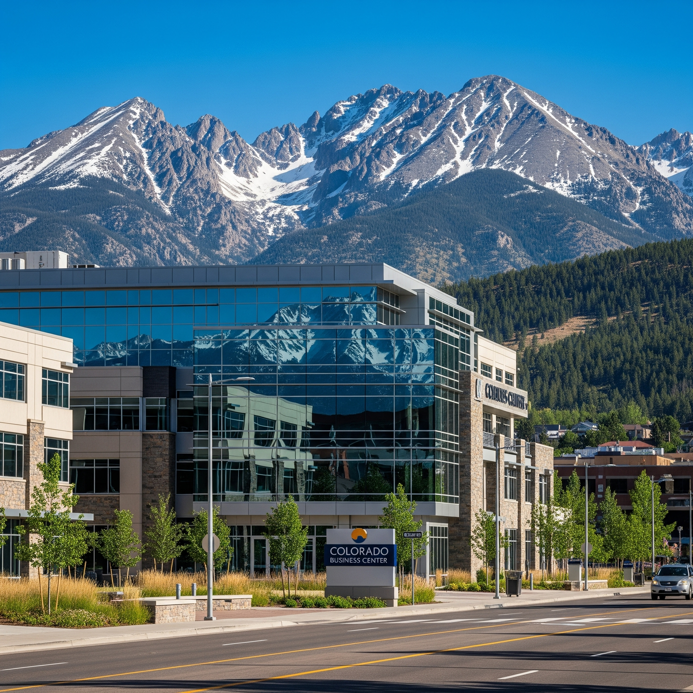


Centralized
Leasing
Policy

Slide 6
C.R.S. § 24-30-1303(1)
a. Negotiate and execute leases with private lessors and state owned lands
b. Negotiate and approve easements and rights-of-way
h. Develop office space occupancy standards
Applies to all space acquisitions whether by lease, sublease, lease/ purchase or license

Slide 7
Statutory Authority
C.R.S. § 24-30-1303.5
(1) Maintain an inventory of all state-owned lands and buildings. Maintain an inventory of all leases. Correct any defects in order to vest marketable title in the state.
(3) Establish procedure for required reporting of all acquisitions and dispositions of real property.
(6) Prepare and provide an annual report of acquisitions and dispositions to the CDC

Slide 8
Real Estate Transactions
Ensure they serve the needs of the State
Are completed according to specific requirements set out in the state’s constitution, statutes, fiscal rules, and official policies and procedures
Most importantly, must represent a fair value to the State in the prevailing market conditions

Slide 9
Responsibilities include:
1. Review and approval of real estate contracts
2. Coordinate real estate activities with the state's real estate support services vendor
3. Maintain an inventory of state-owned and leased properties
4. Develop a centralized leasing policy and office space standards for leased space
5. Annually report acquisitions, dispositions and lease summaries to the Colorado General Assembly’s Capital Development Committee

Slide 10
Real Estate Delegate Authority
Limited delegation of authority is made available pursuant to the authority granted in 24-30-1303 (5) (a) C.R.S.
Responsible for being the primary point of contact for real estate matters
Different from the State Buildings Delegate
Must be obtained in writing from DPA and OSA

Slide 11
Leasing
Procedures

Slide 12
Basic Steps
1- Request and Approval Phase
2- Engagement Phase
3- Transaction Phase

Slide 13
1 - Request and Approval Phase
Submit Space Request Form to REP - New web form
Consult to review needs, confirm budget has been secured, review colocation options, and determine Broker involvement
Engage State Service Broker - Tenant Authorization Agreement
In locations not covered by state service broker, determine if outside broker to be used or if agency or institution handle internally with REP oversight

Slide 14
2- Engagement Phase
Consult with Broker
Review needs (square footage, location, type, etc.)
Discuss current market conditions
Tour possible locations
Analyze options

Slide 15
3 - Transaction Phase
Solicit offers from preferred locations (RFP)
Review financial analysis, Select location
Broker prepares lease draft, submits to landlord
Negotiations
Final approvals and signatures

Slide 16
Tax Exempt Leases
As of 2009, the State is exempt from the levy and collection of property tax on all State leased properties during the term of the use and possession of the property.
Minimum one year term.
Applies to land leases as well as building leases.
Department is responsible for filing lease copies with the county.

Slide 17
State Service Broker
In the seven county metro area, executive branch State agencies must use the State real estate service broker for any real estate transaction activity (new lease, amending current lease, buying or selling)
In rare exceptions, Agencies may apply for a waiver to utilize the services of a non-State contracted real estate broker.
Reviewed on a case-by-case basis
Require written approval by the Real Estate Program manager prior to any engagement of a broker.

Slide 18
Specific Counties
Denver Metro Area -
Adams, Arapahoe, Broomfield, Boulder, Denver, Douglas and Jefferson
Covered by JLL
El Paso and Pueblo Counties -
Covered by SOCO Commercial Group

Slide 19
Professional Real Estate Representation
Provides significant advantages to the State
Save time and money
Conduct needs assessments and space programming
Knowledge of the complicated state processes
Effectively advocate for state departments
Assures State dollars are spent wisely

Slide 20
Document Drafting
If Broker is involved, Broker will draft documents.
Lease templates include:
Gross Lease
Lease Amendment
Interagency Lease
Interagency Amendment
Sublease
State Owned Lease
Easement - Grantor
Easement - Grantee
License Agreement
Parking Agreement

Slide 21
Document Review
The fewer variations from the State's lease template, the faster the lease will move through the approval process
All of the wording in the standard templates has been pre-approved by the Attorney General's office and the State Controller’s Office
If changes are necessary, submit before finalizing negotiations for REP for a preliminary opinion on the likelihood of approval of the changes

Slide 22
Signature Authority
1) Tenant
2) Landlord
3) Real Estate Programs
4) Legal (if necessary)
5) Risk (if necessary)
6) Controller (final approval)
No lease is valid, no rents authorized, until the State Controller approves and signs

Slide 23
Acquisitions
and
Dispositions

Slide 24
Statutory Authority – A & D
C.R.S. § 24-30-1301(2)
Capital construction includes:
“Acquisition of a capital asset or disposition, construction, demolition, remodeling or renovation, site improvement or development of real property…”
Requires the Real Estate Program to be actively involved in, and sign off on, the acquisition of real estate.

Slide 25
Acquisitions = Purchases
Request assistance from ELT and REP with decision making early as possible
Notify OSPB of intent to acquire property
Evaluate alternative strategies- co-location, renovation, construction
Determine funding source and payment method
Engage state service broker
Verify necessary approvals- OSPB, CDHE, CDC, legislature, AG

Slide 26
Dispositions = Sales
Request assistance from ELT and REP with decision making early as possible
Notify OSPB or CCHE of intent
Verify necessary approvals- OSPB, CDHE, CDC, legislature, Attorney General
Prepare file documentation- survey, title commitment, environmental study, appraisal, property condition report, ADA assessment, historical preservation
Determine method of sale- sealed bid, broker listing

Slide 27
Title Transfers
Some departments have statutory authority to conduct acquisitions and dispositions of real property within their agency.
Disposition process can be lengthy, lasting multiple years and spanning multiple phases depending on the size and scope of the project. Can be more efficient to first transfer the property title to DPA, allowing for the Real Estate Program to oversee the fulfillment process of these complicated transactions.

Slide 28
P3 Unit (Public Private Partnership)
Created in 2022 through Colorado legislation (SB 22-130)
Focuses on redeveloping eligible state-owned facilities that are currently being unused or underutilized
Proceeds from the sale of these properties, per statute, go to the unused property fund
Real Estate Programs involved for technical assistance and advice regarding the specific nuances of real estate transactions

Slide 29
Reporting Requirements
Colorado statutes require that all acquisitions and dispositions of real estate by all agencies and institutions of higher education must be reported to the Real Estate Program.
Exceptions for State Land Board, Parks & Wildlife, and CDOT
Used to fulfill multiple statutory responsibilities for maintaining current inventories

Slide 30
Also review
• Colorado Constitution
• Colorado Revised Statutes, as amended, C.R.S. § 24-30-1303
• Department of Law policies
• Fiscal Rules (issued by the State Controller)
• State of Colorado Contract Procedures and Management Manual
• Executive orders (issued by the Governor)

Slide 31
Real Estate Program Staff
Cameron Kennedy- Real Estate Program Manager
cameron.kennedy@state.co.us
720-402-4146
Jennifer Threlkeld- Real Estate Specialist
jennifer.threlkeld@state.co.us
720-813-7642

